Slide 1
Lesson7
What’s the date today?
Jīn tiān jǐ hào？

Slide 2
Year
Nián

Slide 3
Month
Yuè

Slide 4
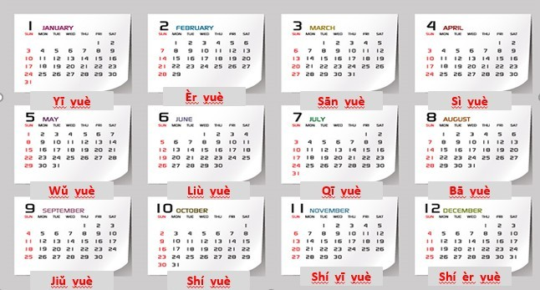

Slide 5
date,number
Hào

Slide 6
Year month date
Nián yuè hào
Example:
2019Nián11yuè 13hào

Slide 7
Day
Tiān

Slide 8
This year：
Jīn nián
Today：
Jīn tiān

Slide 9
What’s the date today?
Q: Jīn tiān jǐ hào？
A:Jīn tiān (__ yuè) __ hào.

Slide 10
Week
Xīng qī

Slide 11
Xīng qī yī
1.Monday
2.Tuesday
3.Wednesday
4.Thursday
5.Friday
6.Saturday
7.Sunday
Xīng qī èr
Xīng qī sān
Xīng qī sì
Xīng qī wǔ
Xīng qī liù
Xīng qī tiān

Slide 12
What’s the day today?
Q: Jīn tiān xīng qī jǐ？
A: Jīn tiān xīng qī + number

Slide 13
Jīn tiān jǐ hào ？
Jīn tiān xīng qī jǐ ？
Zuó tiān jǐ hào ？
Zuó tiān xīng qī jǐ ？
Míng tiān jǐ hào ?
Ming tiān xīng qī jǐ ?

Slide 14
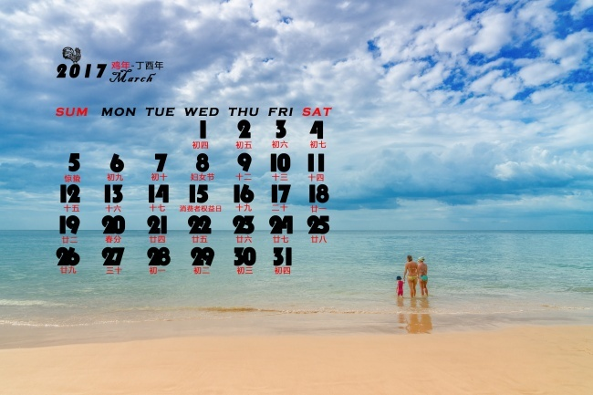
__yuè__hào shì xīng qī jǐ?

Slide 15
Text1
New words

Slide 16
Qǐng wèn
Please ：Qǐng
Example:
Please speak： qǐng shuō
Come in please: qǐng jìn

Slide 17

Ask: 问wèn
Excuse me: Qǐng wèn

Slide 18
Text1
A: Qǐng wèn , jīn tiān jǐ hào ？
B: Jīn tiān 9yuè 1hào.
A: Jīn tiān xīng qī jǐ ？
B: Xīng qī 3.

Slide 19
Text2
New words

Slide 20
Yesterday
Today
Tomorrow
Zuó tiān
Jīn tiān
Míng tiān

Slide 21
Text2
A: Zuó tiān shì jǐ yuè jǐ hào ？
B: Zuó tiān shì 8yuè 31hào , xīng qī 2.
A: Míng tiān ne ？
B: Míng tiān shì 9yuè 2hào, xīng qī 4.

Slide 22
Chinese word order rule
+
+
+
When
Subject
Where
Action

Slide 23
Text3
A: Míng tiān xīng qī 6 ,
nǐ qù xué xiào ma ?
B: Wǒ qù xué xiào.
A: Nǐ qù xué xiào zuò shén me ?
B: Wǒ qù xué xiào kàn shū.
go
School
reading

